Slide 1
CHAPTER 1
BASIC CONCEPT
All the programs in this file are selected from
Ellis Horowitz, Sartaj Sahni, and Susan Anderson-Freed
“Fundamentals of Data Structures in C”,
Computer Science Press, 1992.
CHAPTER 1
1

Slide 2
How to create programs
Requirements
Analysis: bottom-up vs. top-down
Design: data objects and operations
Refinement and Coding
Verification
  Program Proving
  Testing
  Debugging
CHAPTER 1

Slide 3
Algorithm
Definition
An algorithm is a finite set of instructions that accomplishes a particular task.
Criteria
  input
  output
  definiteness: clear and unambiguous
  finiteness: terminate after a finite number of steps
  effectiveness: instruction is basic enough to be carried out
CHAPTER 1

Slide 4
Data Type
Data Type
A data type is a collection of objects and a set of operations that act on those objects.
Abstract Data Type
An abstract data type(ADT) is a data type that is organized in such a way that the specification of the objects and the operations on the objects is separated from the representation of the objects and the implementation of the operations.
CHAPTER 1

Slide 5
Specification vs. Implementation
Operation specification
  function name
  the types of arguments
  the type of the results
Implementation independent
CHAPTER 1

Slide 6
*Structure 1.1:Abstract data type Natural_Number (p.17) structure Natural_Number is objects: an ordered subrange of the integers starting at zero and ending at the maximum integer (INT_MAX) on the computer functions: for all x, y ∈ Nat_Number; TRUE, FALSE ∈ Boolean and where +, -, <, and == are the usual integer operations.
Nat_No Zero ( ) ::= 0
Boolean Is_Zero(x) ::= if (x) return FALSE else return TRUE
Nat_No Add(x, y) ::= if ((x+y) <= INT_MAX) return x+y else return INT_MAX
Boolean Equal(x,y) ::= if (x== y) return TRUE else return FALSE
Nat_No Successor(x) ::= if (x == INT_MAX) return x else return x+1
Nat_No Subtract(x,y) ::= if (x<y) return 0 else return x-y end Natural_Number
::= is defined as
CHAPTER 1

Slide 7
Space Complexity
S(P)=C+S_{P}(I)
The space needed by a program is the sum of the following components:
  Fixed Space Requirements (C)
  Variable Space Requirements (S_{P}(I))
CHAPTER 1

Slide 8
Fixed Space Requirements (C)
Independent of the characteristics of the inputs and outputs
  instruction space
  space for simple variables, fixed-size structured variable, constants
Variable Space Requirements (S_{P}(I))
depend on the instance characteristic I
  number, size, values of inputs and outputs associated with I
  recursive stack space, formal parameters, local variables, return address
CHAPTER 1

Slide 9
*Program 1.9: Simple arithmetic function (p.19) float abc(float a, float b, float c)
{ return a + b + b * c + (a + b - c) / (a + b) + 4.00;
}
*Program 1.10: Iterative function for summing a list of numbers (p.20) float sum(float list[ ], int n)
{ float tempsum = 0; int i; for (i = 0; i<n; i++) tempsum += list [i]; return tempsum;
}
S_{abc}(I) = 0
S_{sum}(I) = 0
Recall: pass the address of the
first element of the array &
pass by value
CHAPTER 1

Slide 10
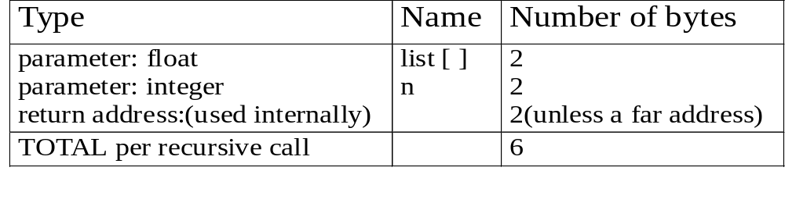
*Program 1.11: Recursive function for summing a list of numbers (p.20) float rsum(float list[ ], int n)
{ if (n) return rsum(list, n-1) + list[n-1]; return 0;
}
*Figure 1.1: Space needed for one recursive call of Program 1.11 (p.21)
S_{sum}(I)=S_{sum}(n)=6n
Assumptions:
CHAPTER 1

Slide 11
Time Complexity
T(P)=C+T_{P}(I)
Compile time (C)
independent of instance characteristics
run (execution) time T_{P}
CHAPTER 1

Slide 12
Time Complexity
A program step is a syntactically or semantically meaningful program segment whose execution time is independent of the instance characteristics.
Example
  abc = a + b + b * c + (a + b - c) / (a + b) + 4.0
  abc = a + b + c
Regard as the same unit
machine independent
CHAPTER 1

Slide 13
Methods to compute the step count
Introduce variable count into programs
Tabular method
  Determine the total number of steps contributed by each statement
  step per execution × frequency
  add up the contribution of all statements
CHAPTER 1

Slide 14
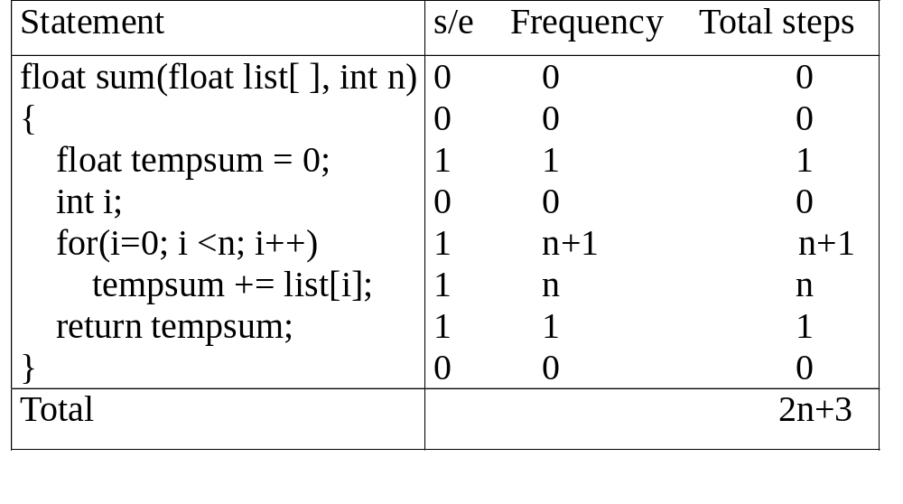
*Figure 1.2: Step count table for Program 1.10 (p.26)
Tabular Method
Iterative function to sum a list of numbers
steps/execution
CHAPTER 1

Slide 15
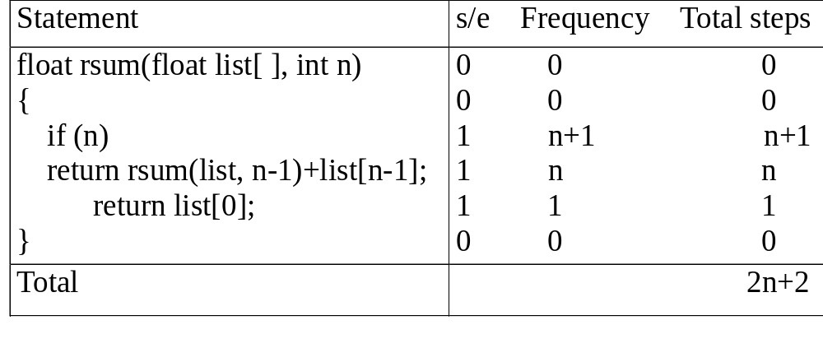
*Figure 1.3: Step count table for recursive summing function (p.27)
Recursive Function to sum of a list of numbers
CHAPTER 1

Slide 16
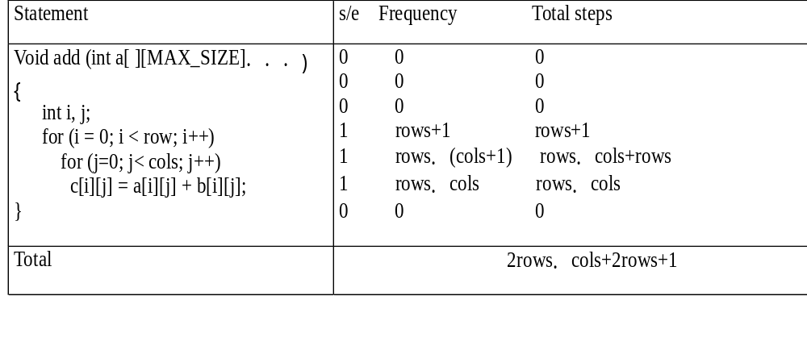
*Figure 1.4: Step count table for matrix addition (p.27)
Matrix Addition
CHAPTER 1

